Slide 1

Introduction to Git
A Distributed Version Control System

Slide 2
Version Control History
Version control is a system that records changes to a file or set of files over time so that you can recall specific versions later
Many people’s version-control method of choice was to copy files into another directory
Local Version Control Systems(LVCS)
Centralized Version Control Systems(CVCS)
Distributed Version Control Systems(DVCS)
Notes:
a Version Control System (VCS) is a very wise thing to use. It allows you to revert selected files back to a previous state, revert the entire project back to a previous state, compare changes over time, see who last modified something that might be causing a problem, who introduced an issue and when, and more. Using a VCS also generally means that if you screw things up or lose files, you can easily recover. In addition, you get all this for very little overhead.

Slide 3

Local Version Control Systems
Notes:
Many people’s version-control method of choice is to copy files into another directory (perhaps a time-stamped directory, if they’re clever). This approach is very common because it is so simple, but it is also incredibly error prone. It is easy to forget which directory you’re in and accidentally write to the wrong file or copy over files you don’t mean to.
To deal with this issue, programmers long ago developed local VCSs that had a simple database that kept all the changes to files under revision control.

Slide 4
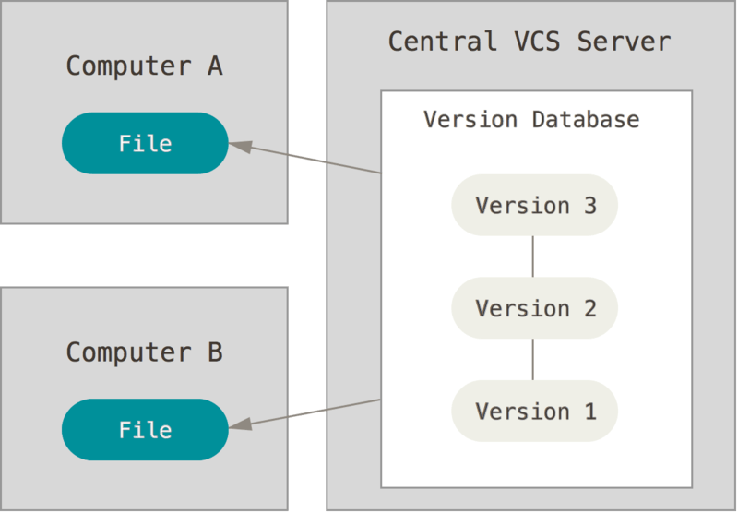
Centralized Version Control Systems
Notes:
The next major issue that people encounter is that they need to collaborate with developers on other systems. To deal with this problem, Centralized Version Control Systems (CVCSs) were developed. These systems (such as CVS, Subversion, and Perforce) have a single server that contains all the versioned files, and a number of clients that check out files from that central place. For many years, this has been the standard for version control.
This setup offers many advantages, especially over local VCSs. For example, everyone knows to a certain degree what everyone else on the project is doing. Administrators have fine-grained control over who can do what, and it’s far easier to administer a CVCS than it is to deal with local databases on every client.
However, this setup also has some serious downsides. The most obvious is the single point of failure that the centralized server represents. If that server goes down for an hour, then during that hour nobody can collaborate at all or save versioned changes to anything they’re working on. If the hard disk the central database is on becomes corrupted, and proper backups haven’t been kept, you lose absolutely everything — the entire history of the project except whatever single snapshots people happen to have on their local machines. Local VCSs suffer from this same problem — whenever you have the entire history of the project in a single place, you risk losing everything.

Slide 5
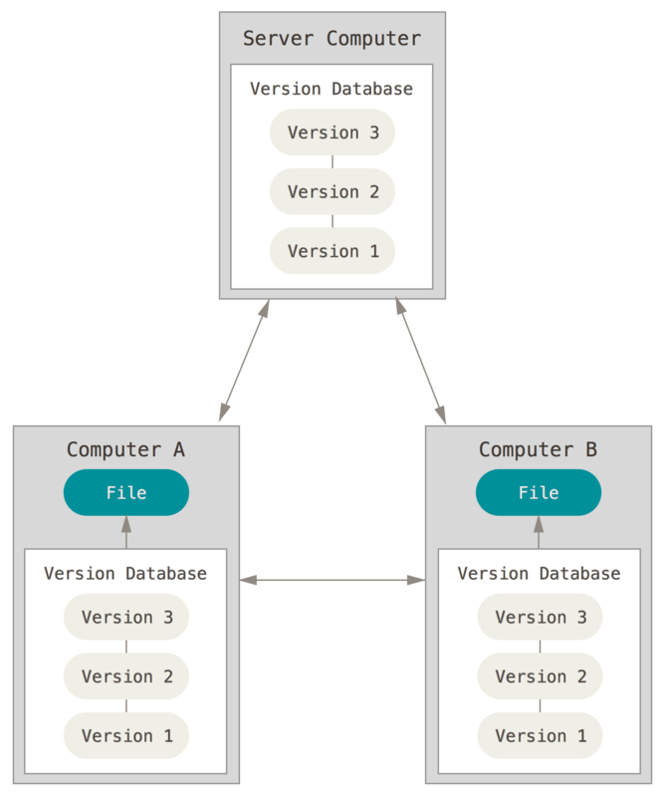
Distributed Version Control Systems
Notes:
This is where Distributed Version Control Systems (DVCSs) step in. In a DVCS (such as Git, Mercurial, Bazaar or Darcs), clients don’t just check out the latest snapshot of the files; rather, they fully mirror the repository, including its full history. Thus, if any server dies, and these systems were collaborating via that server, any of the client repositories can be copied back up to the server to restore it. Every clone is really a full backup of all the data.
Furthermore, many of these systems deal pretty well with having several remote repositories they can work with, so you can collaborate with different groups of people in different ways simultaneously within the same project. This allows you to set up several types of workflows that aren’t possible in centralized systems, such as hierarchical models.

Slide 6
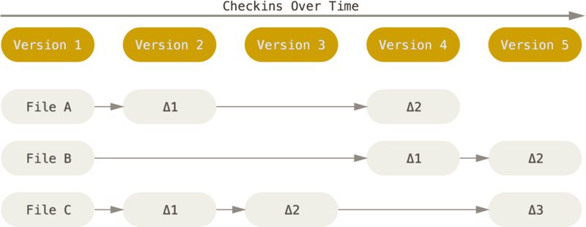
What is Git ?
Differences, this is what was used mostly before git
Notes:
The major difference between Git and any other VCS (Subversion and friends included) is the way Git thinks about its data. Conceptually, most other systems store information as a list of file-based changes. These other systems (CVS, Subversion, Perforce, Bazaar, and so on) think of the information they store as a set of files and the changes made to each file over time (this is commonly described as delta-based version control).

Slide 7
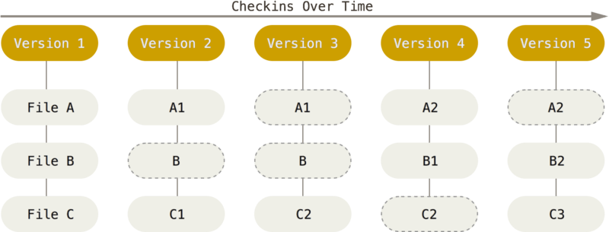
What is Git ?
Snapshots, Not Differences. This is what Git uses
Notes:
Git doesn’t think of or store its data this way. Instead, Git thinks of its data more like a series of snapshots of a miniature filesystem. With Git, every time you commit, or save the state of your project, Git basically takes a picture of what all your files look like at that moment and stores a reference to that snapshot. To be efficient, if files have not changed, Git doesn’t store the file again, just a link to the previous identical file it has already stored. Git thinks about its data more like a stream of snapshots.

Slide 8
Features of Git
Nearly Every Operation Is Local
Git Has Integrity
Git Generally Only Adds Data
Notes:
Most operations in Git need only local files and resources to operate — generally no information is needed from another computer on your network.
Everything in Git is checksummed before it is stored and is then referred to by that checksum. This means it’s impossible to change the contents of any file or directory without Git knowing about it. This functionality is built into Git at the lowest levels and is integral to its philosophy. You can’t lose information in transit or get file corruption without Git being able to detect it.
When you do actions in Git, nearly all of them only add data to the Git database. It is hard to get the system to do anything that is not undoable or to make it erase data in any way.

Slide 9
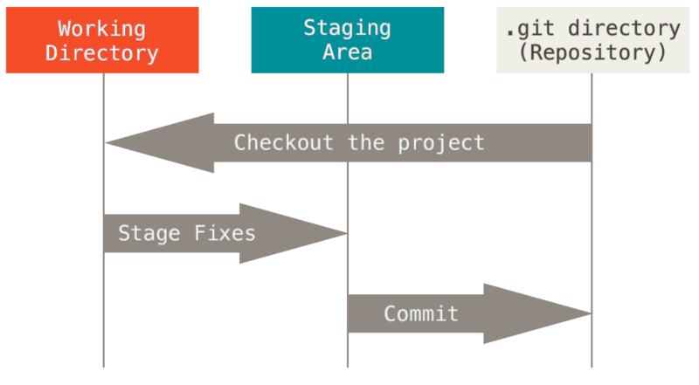
The Three Stages
Notes:
Pay attention now — here is the main thing to remember about Git if you want the rest of your learning process to go smoothly.
Git has three main states that your files can reside in: modified, staged, and committed:
Modified means that you have changed the file but have not committed it to your database yet.
Staged means that you have marked a modified file in its current version to go into your next commit snapshot.
Committed means that the data is safely stored in your local database.
This leads us to the three main sections of a Git project: the working tree, the staging area, and the Git directory.

Slide 10
Installation

Slide 11
Installation
Windows
https://git-scm.com/download/win
Mac
Install the Xcode Command Line Tools
Or
https://git-scm.com/download/mac.
Linux
sudo apt install git-all

Slide 12
Configuring Git
git config --global user.name "John Doe“
git config --global user.email johndoe@example.com
git config --global init.defaultBranch main
git config --list
Notes:
The first thing you should do when you install Git is to set your user name and email address. This is important because every Git commit uses this information, and it’s immutably baked into the commits you start creating:
By default Git will create a branch called master when you create a new repository with git init. From Git version 2.28 onwards, you can set a different name for the initial branch.

Slide 13
Getting help
git help <verb>
git <verb> --help
git help config
Notes:
If you ever need help while using Git, there are three equivalent ways to get the comprehensive manual page (manpage) help for any of the Git commands:

Slide 14
Git Basics - Getting a Git Repository
You typically obtain a Git repository in one of two ways:
You can take a local directory that is currently not under version control, and turn it into a Git repository (git init), or
You can clone an existing Git repository from elsewhere(git clone).
Notes:
This creates a new subdirectory named .git that contains all of your necessary repository files — a Git repository skeleton. At this point, nothing in your project is tracked yet.
If you want to get a copy of an existing Git repository — for example, a project you’d like to contribute to — the command you need is git clone.

Slide 15
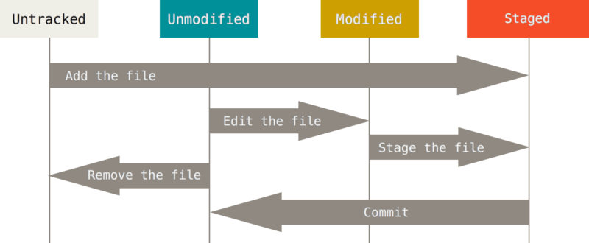
Git Basics - Recording Changes to the Repository
Each file in your working directory can be in one of two states: tracked or untracked.
Notes:
Tracked files are files that were in the last snapshot, as well as any newly staged files; they can be unmodified, modified, or staged. In short, tracked files are files that Git knows about.
Untracked files are everything else — any files in your working directory that were not in your last snapshot and are not in your staging area
As you edit files, Git sees them as modified, because you’ve changed them since your last commit. As you work, you selectively stage these modified files and then commit all those staged changes, and the cycle repeats.

Slide 16
Git Basics – Commands
Checking the Status of Your Files (git status)
Tracking New Files(git add)
Staging Modified Files(git add)
Ignoring Files(.gitignore)
Viewing Your Staged and Unstaged Changes(git diff, git diff --staged)
Committing Your Changes(git commit).
Removing Files(git rm)

Slide 17
Git Basics - Viewing the Commit History
After you have created several commits, or if you have cloned a repository with an existing commit history, you’ll probably want to look back to see what has happened. The most basic and powerful tool to do this is the git log command.
git log lists the commits made in that repository in reverse chronological order; that is, the most recent commits show up first.

Slide 18
Git Basics - Undoing things with git restore
Unmodifying a Modified File with (git restore)
Going to previous commit with git checkout

Slide 19
Git- Things to come
Git Branching
Git Remote Repositories

